Slide 1
Vibe Check 2024
CIS 6905 September 5, 2024
Deeptika Kannan

Slide 2
Summary of progress
Pulled all comments from YouTube videos of presidential debates
2020: C-SPAN, CBS, Fox News, NBC, Sky News
2024: C-SPAN, MSNBC, NBC, USA Today, Wall Street Journal
Added all downloaded comments into separate CSV files
Dataset attributes: 'author','published_at','like_count','text’
Performed an initial exploratory data analysis on each dataset
Initial statistics visualized
Ydata-profiler used to generate detailed statistics in HTML files
Word clouds generated

Slide 3
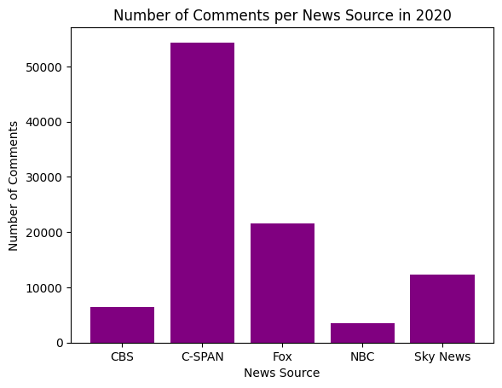
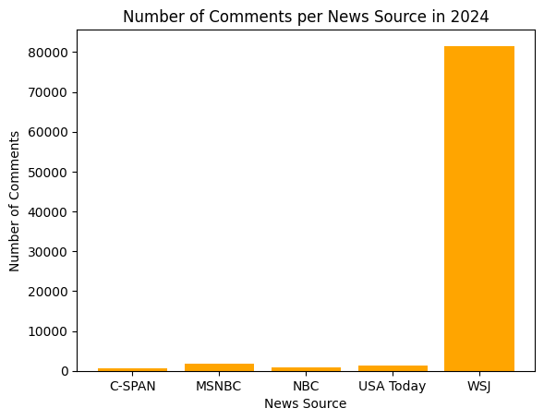
Wins
Compiled a dataset of
98094 comments in 2020 and
86131 comments in 2024

Slide 4
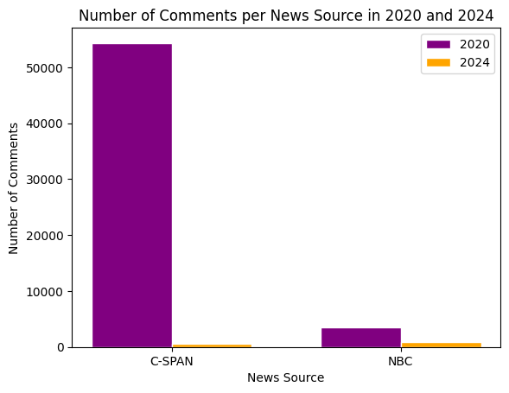
Comparing the same news sources from 2020 and 2024

Slide 5
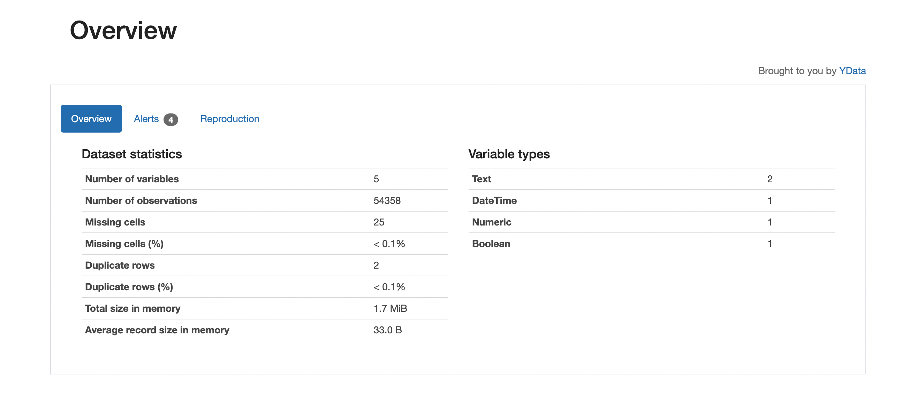
Ydata-profiler analysis
Generated a detailed data profile using this Python package
Includes data statistics, author counts, likes frequency, and text analysis of comments
In data/data profiles directory

Slide 6
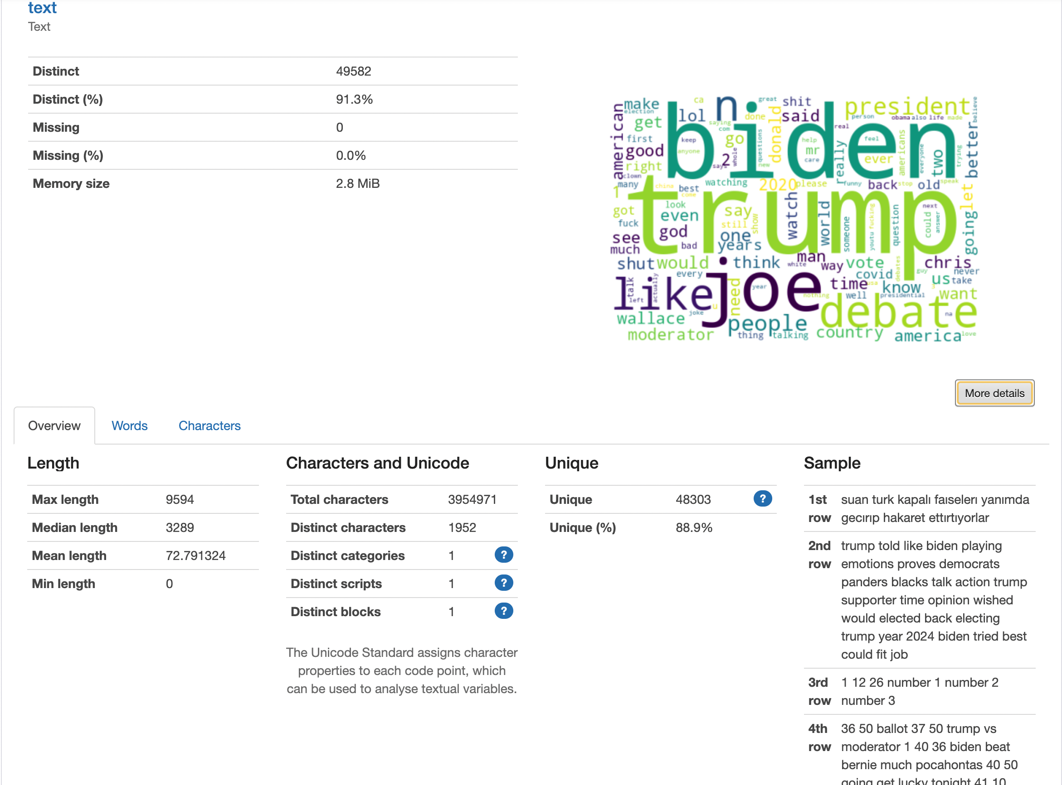
Ydata-profiler analysis
A sample comment text analysis from C-SPAN 2020 comments:

Slide 7
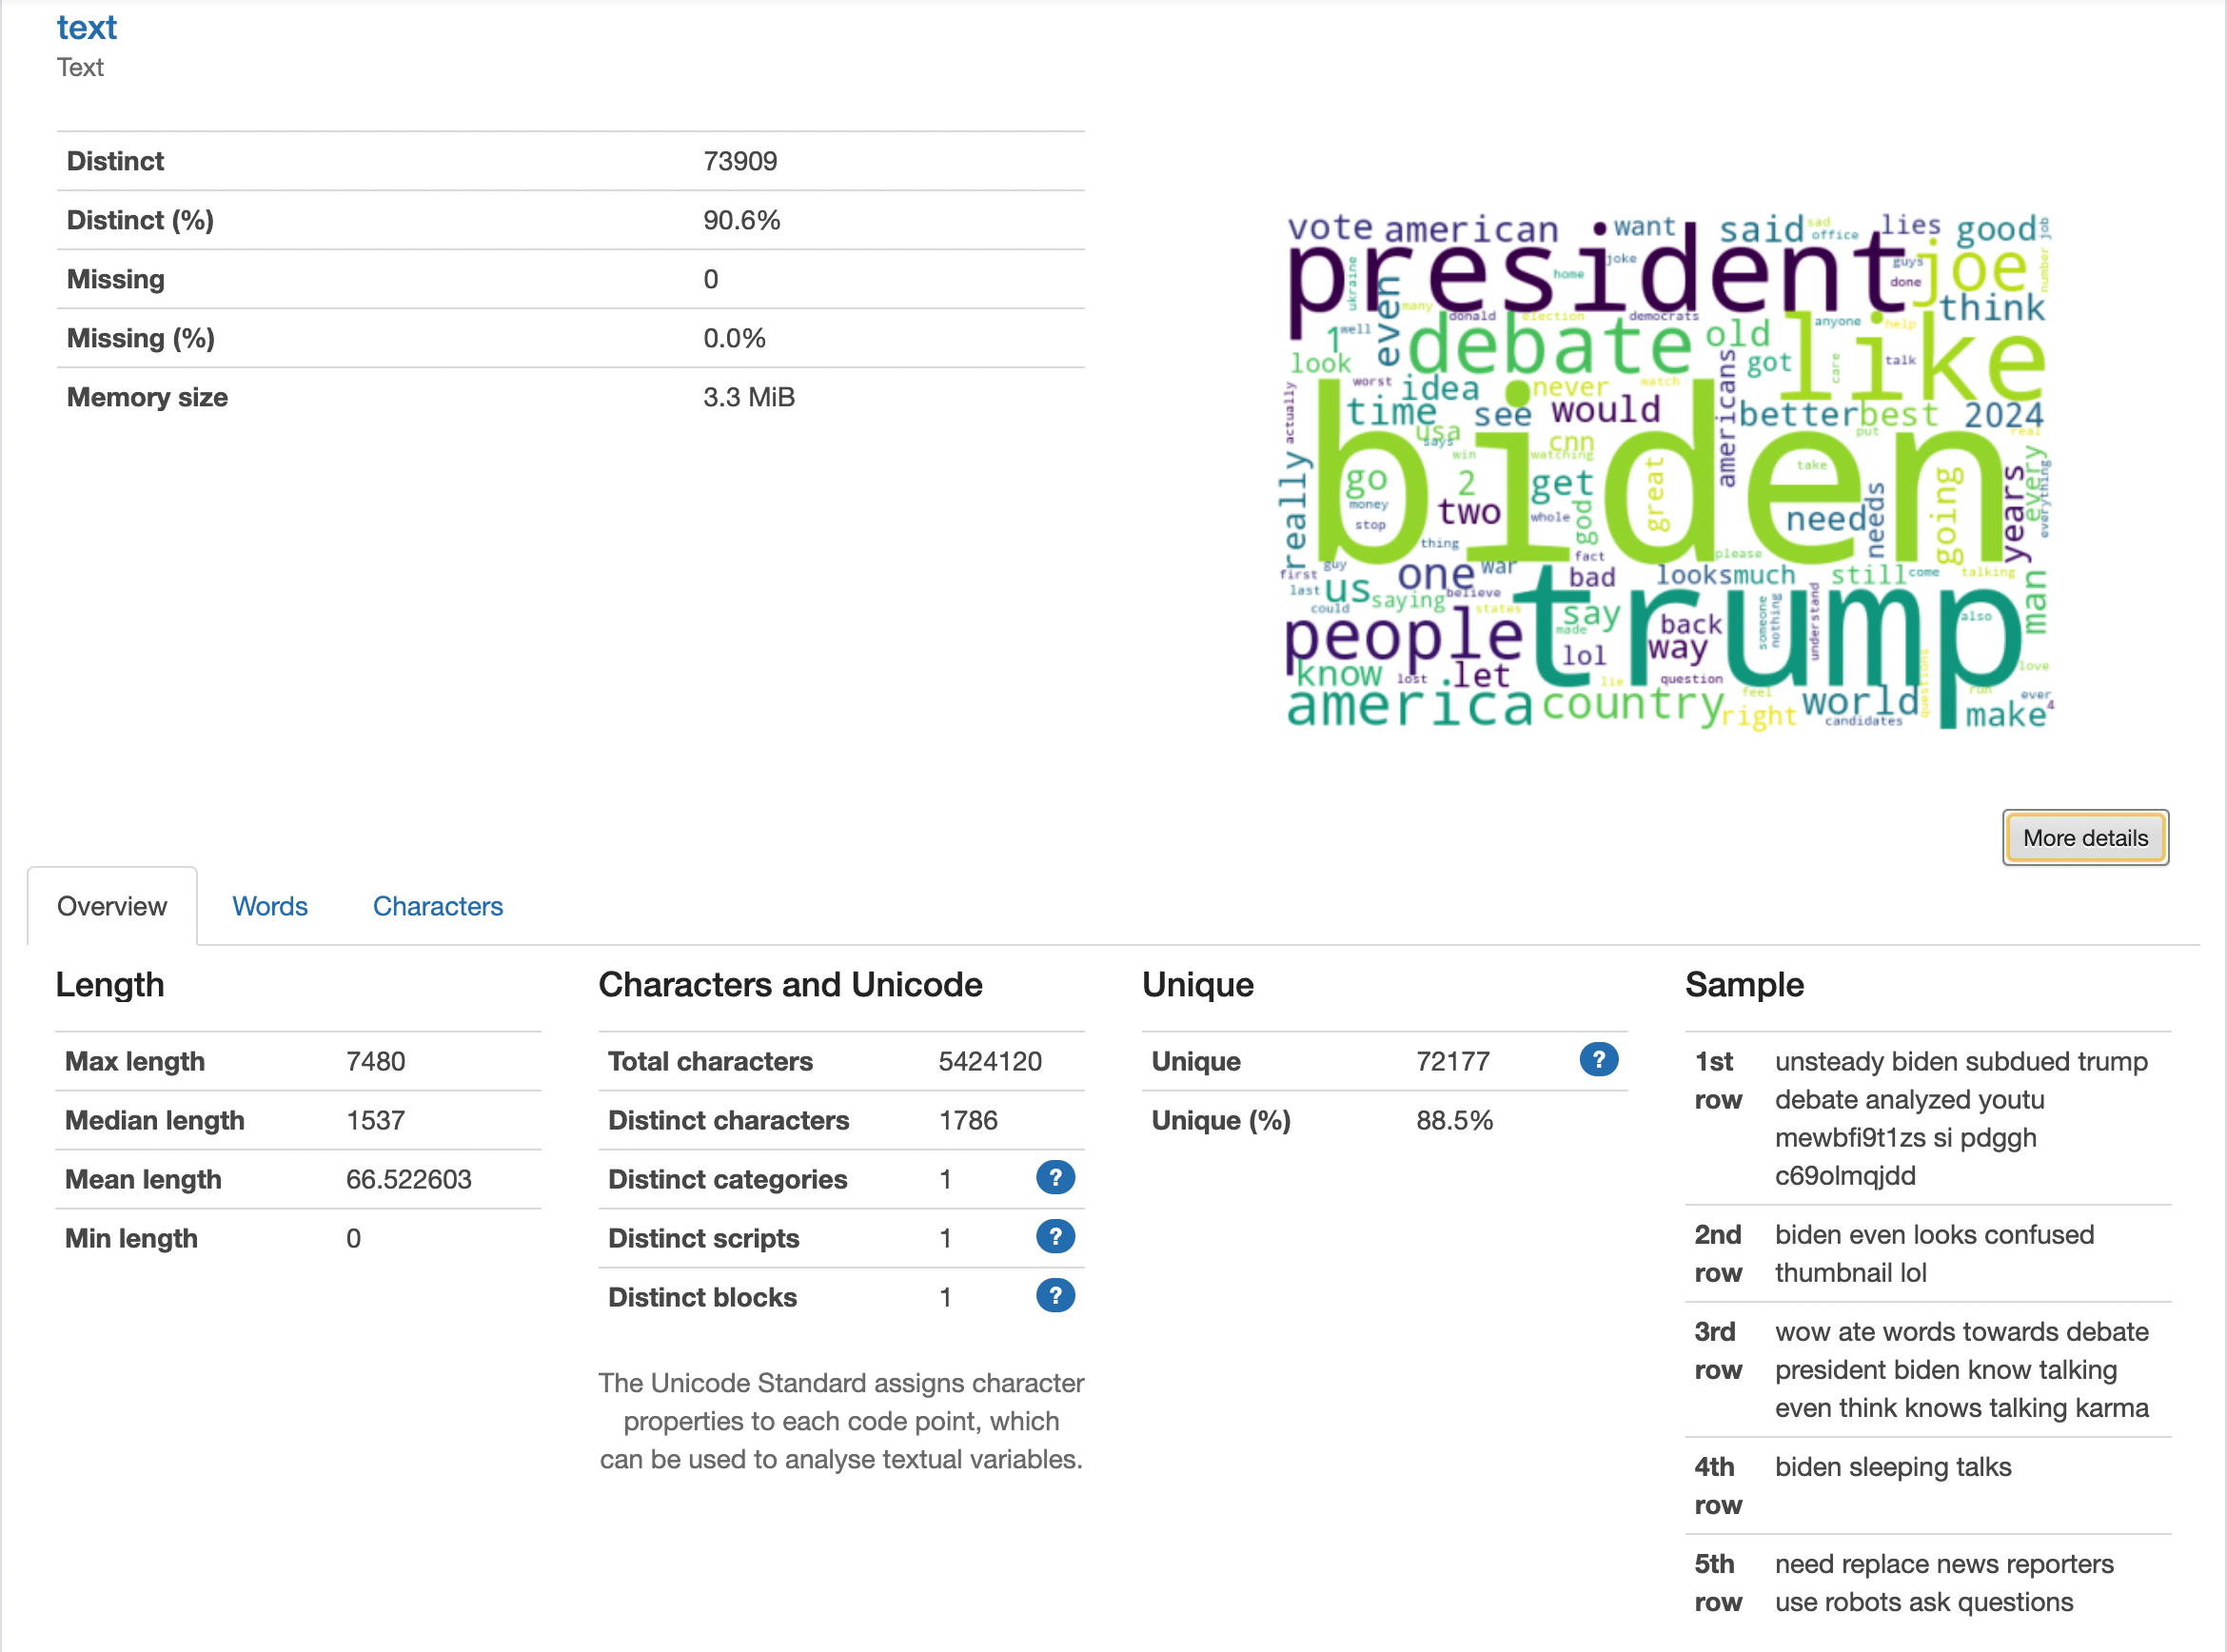
Ydata-profiler analysis
A sample comment text analysis from Wall Street Journal 2024 comments:

Slide 8
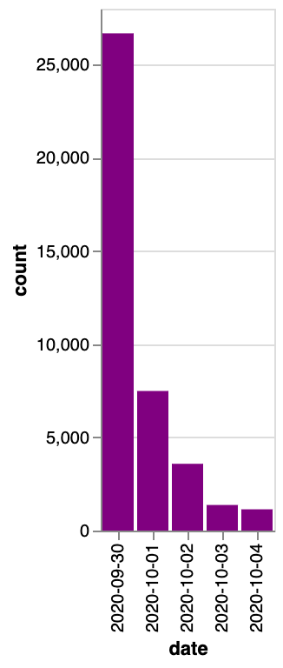
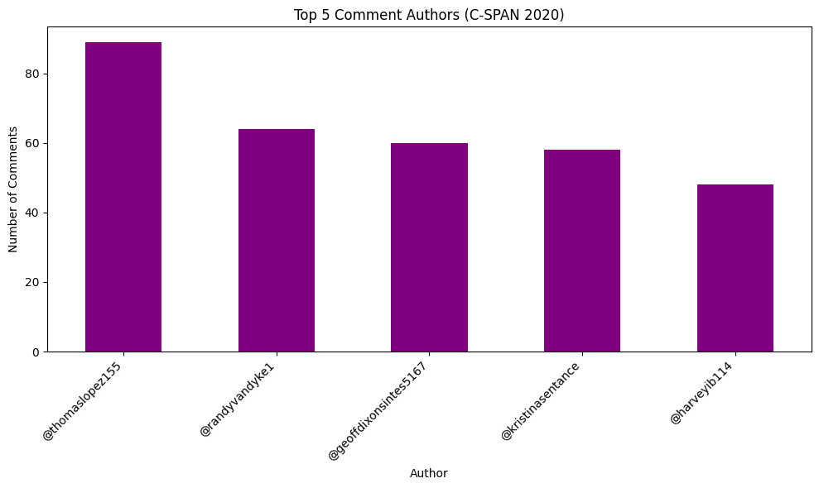
2020 Comments
Picked the network with most comments:
C-SPAN (54,358 comments)

Slide 9
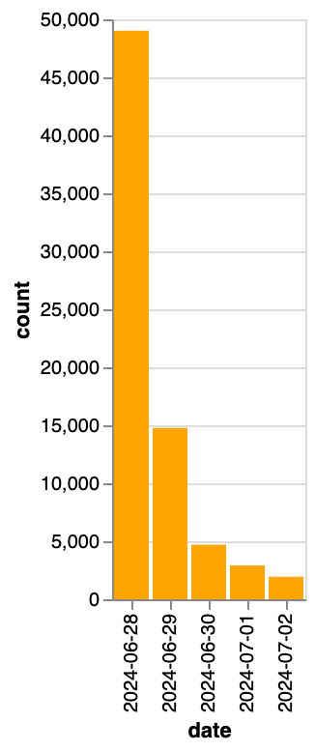
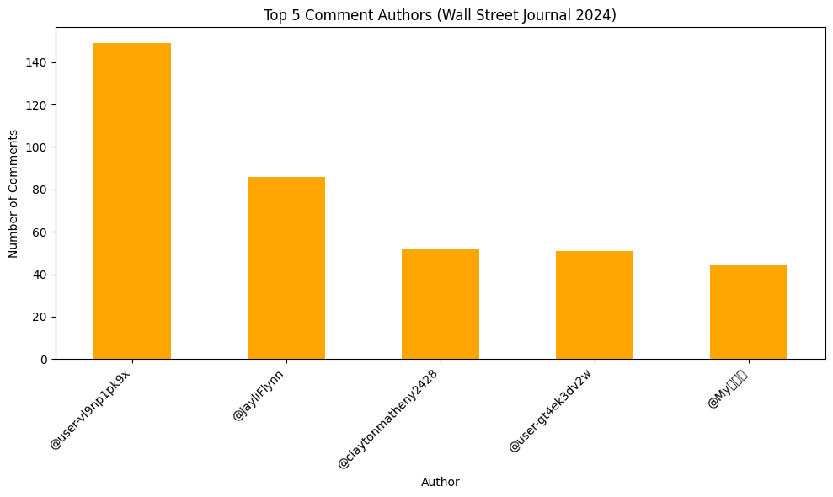
2024 Comments
Picked the network with most comments:
Wall Street Journal (81,603 comments)

Slide 10
Observations
Nested comments – not pulled by API
Eg: Wall Street Journal has a total of 129k comments but only 54k were pulled
Youtube API key currently in an env file
Some videos have disabled comments – HttpError raised but information pulled
Some comments are in different languages

Slide 11
Github Repository
https://github.com/akash-2303/Election-Data.git

